Slide 1
MVC Routing
A route is a URL pattern that is mapped to a handler.
The handler can be a physical file, such as an .aspx file in a Web Forms application. A handler can also be a class that processes the request, such as a controller in an MVC application.

Slide 2
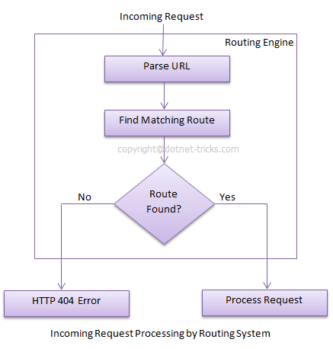
MVC Routing

Slide 3
MVC Routing
Request URL | Parameters
http://example.com/ | controller=Home, action=Index, id=none, Since default value of controller and action are Home and Index respectively.
http://example.com/Admin | controller=Admin, action=Index, id=none, Since default value of action is Index
http://example.com/Admin/Product | controller=Admin, action=Product, id=none
http://example.com/Admin/Product/1 | controller=Admin, action=Product, id=1
http://example.com/Admin/Product/SubAdmin/1 | No Match Found
http://example.com/Admin/Product/SubAdmin/Add/1 | No Match Found

